Slide 2
https://www.youtube.com/watch?v=d7-KJbyMqec&ab_channel=JonasSuarez

Slide 3
12 leyes UX/UI
https://www.youtube.com/watch?v=ABggYX2jOsM&ab_channel=SoyDalto

Slide 4
Creacion de portafolio
https://www.youtube.com/watch?v=hB5DrU6ZykU&ab_channel=GreciaOmana

Slide 5
https://www.youtube.com/watch?v=WYbh60FijSM&ab_channel=TEDxTalks

Slide 6
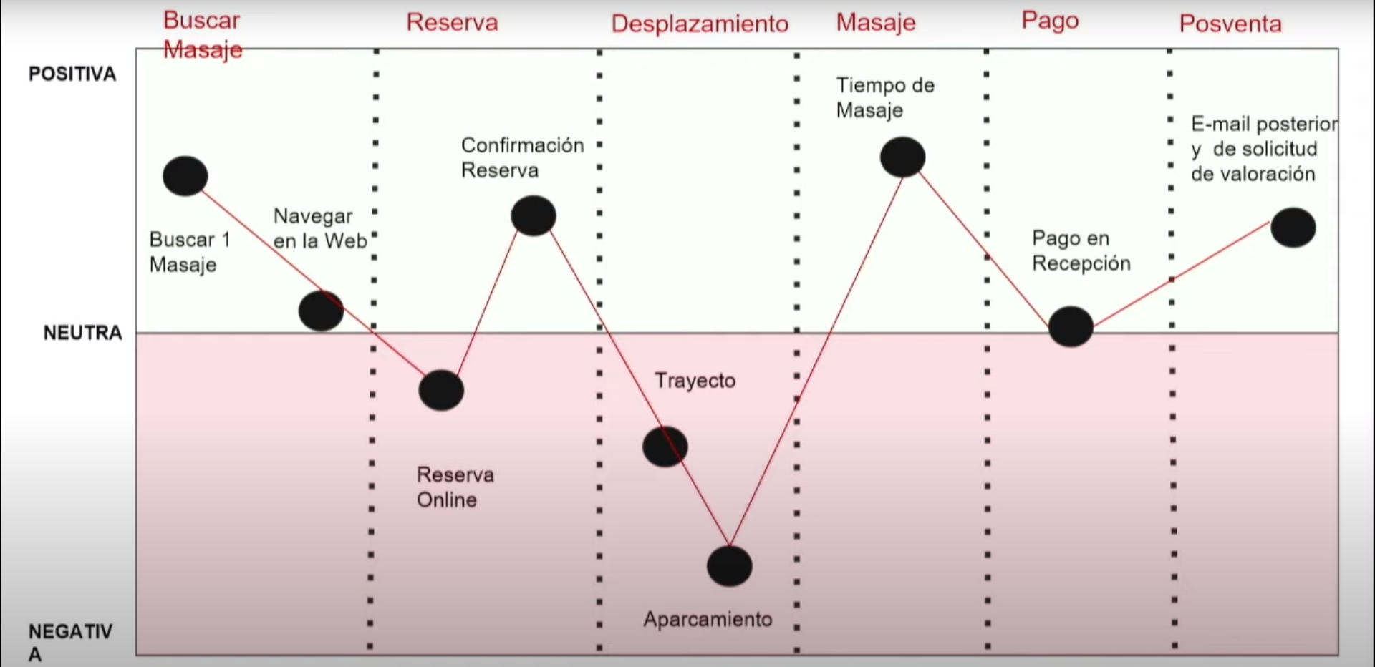
Coustomer journey map:
https://www.youtube.com/watch?v=WYbh60FijSM&ab_channel=TEDxTalks

